Slide 1
Product Management Assignment
Freshflows

Slide 2
Problem Statement
Business Analysts/Product Managers/Product Owners work on multiple requirements, research and analysis, interviews, prioritization, documentation, walkthroughs, demos, training, marketing etc.
Similarly, each team (PM, Design, Dev, QA, Marketing, Sales) works on a bunch of tasks but teams face issues in coordinating or collaborating, for instance, requirements could be missed in translation, status updates are not clear or metrics are not tracked etc.

Slide 3
Business Goals
There are a bunch of project mgmt/task mgmt/backlog tools but the goal of Freshflows is to help product companies/startups execute well.
Teams use different document templates and process workflows to do research, understand the market before beginning to build and get work done.. We want to simplify that and make the process more effective.

Slide 4
Assumptions
This tool has to cater to only small and medium businesses and is not built for enterprise
We will be building the app for use by all teams and not to cater to any specific teams.
There is no existing tool to cater to any of the user needs within the org and the tool is being built from scratch
The team will be using one tool for its end to end product and project management

Slide 5
User Personas - Kevin
Kevin is a product manager of a SAAS team. He manages a web based ecommerce application. He is based out of US.
Behavior
Defines the product strategy and roadmap based on organization strategy and vision
Manages the complete product development cycle from ideation to launch
Attends a lot of meetings and is very busy
Needs and Goals
Needs one tool to manage all his tasks
He needs the software to also track status of the product and related tasks in its various phases
Needs a reporting system to report to management about the status of the products he is handling
Needs a tool to communicate the various tasks and product requirements to the various teams
He needs a documentation creation and sharing tool

Slide 6
User Personas - Ramakrishna
Ramakrishna is a project manager of the SAAS team. He manages the end to end development of the SAAS application. He works out of India. He is working from home.
Behavior
Defines project plan
Manages the development cycle
Coordinates the testing and deployment of the system and application architecture
Communicates with the Product Manager for the requirements and with the VP-Engg for the daily status updates
Needs and Goals
Needs one tool to manage all his tasks
He needs the software to also track status of the various tasks and assign tasks to the teams
Needs a reporting system to report to the rest of the organization about the status of the activities he is handling
Needs a software to plan and manage his projects

Slide 7
User Personas - Ganesh
Ganesh is a VP - Engineering of the SAAS team. He is responsible for the final delivery of the complete application, including architecture, setup, etc. He works out of India.
Behavior
Manages the status of the developments, engineering purchases, testing setups and deployments.
Communicates with the CXO team for all the engineering issues
Needs and Goals
Needs one tool to communicate with the CXO’s
He needs the software to also track status of the various teams and assign tasks to the teams
Needs a reporting system to report to the rest of the organization about the status of Engineering
Managing remote teams, needs a tool to manage the teams work.

Slide 8
User Personal - Grace
Grace is a VP - Marketing and Sales of the organization. She is responsible for the marketing and sales of the product. She keeps travelling throughout the world for her work..
Behavior
Creates a GTM strategy based on the product road map
Manages the leads generation, content and sales teams
Needs and Goals
Needs to plan and track the marketing activities
Needs to report the monthly sales and marketing progress to the CXOs
Needs to check the product release plans and plan the marketing strategy accordingly

Slide 9
User Personas - Keertana
Keertana is the CEO and CSO of the organization. She is responsible for the entire organization strategy and decision making. She works out of US. She is usually busy in meetings and dealing with the customers. She keeps travelling to client offices all over the world.
Behavior
Communicates with the customers for new businesses
Communicates with the Product and Engineering team for communicating the strategy and roadmap
Needs and Goals
Needs one tool to communicate with the entire team
Needs all tasks in one place for him to view when he needs to know the status
Needs a tool to communicate to the entire organization
Approve any decisions taken by the Product team after acceptance from the engineering team

Slide 10
Use Cases
Considering all the problems of the user personas, let me list down the use cases.

Slide 11
Kevin - Product Manager Role
As a user I want to define my product strategy based on the organization strategy
As a user I want to build my product roadmap and send a notification to the management team about the same
As a user I want to define business requirements and create wireframes, answer requirements related question to the engineering team
As a user I want to prioritize the requirements
As a user I want to track the status of each requirement in the sprint cycle
As a user I want to create a product release report and communicate to the team and end users
As a user I want to create reports and share them with the team
As a user I want to create and track product metrics
As a user I want to track the entire product cycle
As a user I want to track user feedback
As a user I want to analyze the product metrics and suggest product changes
As a user I want to track new requirements from sales, marketing and other customer facing teams
As a user I want to create parallel product tracking boards which are directly linked to one organization strategy
As a user I want to convert my emails to requirements wherever applicable
As a user I want to understand the process involved in accomplishing various tasks

Slide 12
Ramakrishna - Project Manager Role
As a user I want to create a project plan and plan the project sprints
As a user I want to update status of requirements and share then with the stakeholders.
As a user I want to create reports to share with the different stakeholders.
As a user I want to track status of the activities assigned to my team.
As a user I want to communicate with my team.
As a user I want to communicate with the Product Manager to clarify requirements.
As a user I want to send the sprint plan to the relevant stakeholders.

Slide 13
Ganesh - VP Role
As a user I want to plan the sprints
As a user I want to get clarification of the requirements from the Product Manager
As a user I want to communicate the release plan to the different stakeholders.
As a user I want to track the status of the activities assigned to my team.
As a user I want to conduct team meetings.
As a user I want to request team for status updates.
As a report I want to generate and share reports.
As a user I want to check the priorities of the requirements.
As a user I want to plan the sprints.

Slide 14
Grace - VP Marketing Role
As a user I want to plan my GTM
As a user I want to plan the sales targets
As a user I want to plan marketing activities based on sales targets, GTM and Product release plans
As a user I want to report the status of the set targets
As a user I want to track the marketing and sales activities
As a user I want to generate the metrics report
As a user I want to track product metrics

Slide 15
Keertana - CXO Role
As a user I want to check the status of the tasks assigned to my team
As a user I want to plan meetings
As a user I want to conduct meetings
As a user I want to get reports
As a user I want to set the organization strategy
As a user I want to communicate with my team
As a user I want to check if our product strategy is aligning with the organization strategy

Slide 16
Prioritization
For phase 1 (MVP) I would like to target
Ramakrishna’s use cases except project planning.
For Kevin I will focus on all use cases except the product strategy and its linking with organization strategy, product metrics tracking, user feedback tracking
Also I want to focus on the reporting use cases for Ganesh, Grace and Keertana

Slide 17
Product Overview
List of product capabilities(Phase 1 / MVP)
Create Product roadmap
Enter product requirements
Update the requirement details
Prioritize the requirements
Create the sprint plan
Assign tasks to the team
Get clarity on the requirements
Track status of requirements
Update the status of requirements
Notifications
Communicate with the teams
Track Worklog
Create product release plan and report
Create Reports
Sharing reports with the rest of the team

Slide 18
User Scenarios and Features
# | User Scenarios | Features
1 | Create a Product Roadmap: Kevin opens the application and create an organization and a product under that organization in the system. Kevin then creates the features that are expected for the year and assigns start and end dates to the same. Kevin will also add sub-features wherever applicable. | Create an organization Create a Product Add features and sub features under the product Assign start and end date Create a gantt chart of the data entered Share the product line items and gantt chart with others in the team
2 | Create requirements and prioritize the requirements: Kevin opens the application and goes to the product for which he wants to create the requirements. Create a backlog column and start adding requirements to the same. Kevin will then assign priorities to these requirements based on scores. | Create a requirement Add wireframes to the requirement Add the flows to the requirement Score the requirement based on factors like (market priority, development time, monetization score) Priority should be assigned to the requirement automatically based on the score

Slide 19
User Scenarios and Features
# | User Scenarios | Features
3 | Create the sprint plan and Assign tasks to the team: Ganesh will review the requirements and its priorities and create the sprint plan from the list. Ganesh will then assign these requirements to his teams. | Move the requirements from backlog to sprint Assign start and end date to the requirement Assign the requirement to a team
4 | Get clarity on the requirements, Track status of requirements, Update the status of requirements, Notifications: Ramakrishna will check the requirements and raise a clarification request. Kevin will clarify the same. Ramakrishna will then assign the requirement to an individual. Ramakrishna will track the status of the requirement. Individual will update the status of the requirement regularly. | Raise a question User will receive a notification on the request User will clarify the question Question gets closed and reassigned to the development team User will assign the request to the individual Individual will update the status Users will be able to view the status Send notification to assigned individuals on status updates.

Slide 20
User Scenarios and Features
# | User Scenarios | Features
5 | Communicate with the team and Track worklog: Ramakrishna will send emails to the team. Ramakrishna will chat with individuals in the team. Ganesh will raise a meeting request. All will be able to accept. All will be able to attend the meeting. Meeting will get recorded in the worklog. | Raise a meeting request Attend a meeting Open a chat session and chat with someone
6 | Create product release plan and report, Create Reports, Sharing reports with the rest of the team: Ganesh will create the release report. Ramakrishna will create sprint status report. Kevin will create the roadmap report. All of them will share the reports with the assigned individuals. | Select a template Create the report Share the report

Slide 21
User Journey Maps - Kevin
Create Organization and Products
Create an organization - Workspace under which everyone else will work
Create products under the organization
Create Roadmap
Create feature
Assign start and end date
Export in form of an excel file
Create a gantt chart with this data
Share the gantt chart with others
Add registered users or new email ids to share with
Create backlog
Create a backlog list and create requirements under this list
Upload relevant files to this requirement card like wireframes
Add description to this requirement card
Create flow charts in the requirement card
Assign scores to the requirement card
Create Reports
Create reports
Send the reports to relevant people
Update the requirement
Update the requirement
Provide clarity to the questions asked in the requirement

Slide 22
User Journey Maps - Ramakrishna
View Requirement
Able to read the requirement description and view all the attachments and flowcharts
Able to raise a question about the requirement and assign it to Kevin
Assign requirements to a team members
Update Status
Write comments on the requirement
Describe the current status of the requirement
Change the status of the requirement
Assign the requirement to other teams on need basis
Create Reports
Create reports
Send the reports to relevant people

Slide 23
User Journey Maps - Grace
Add Requirements
Add new requirements to the backlog.
Edit the existing requirement to add details
Mark any requirement as no longer required or urgent
View Report
View reports created by the team.
Create Report
Create marketing and sales target status reports
Share the reports with relevant people
Add new Backlog under an existing product for sales and marketing
Create a Backlog
Move backlog to sprints
Add new requirements
Add details to requirements
Assign Requirements to team members
Track Status of Requirements

Slide 24
User Journey Maps - Ganesh & Keertana
View Report
View reports created by the team.
Download the created report along with relevant data

Slide 25
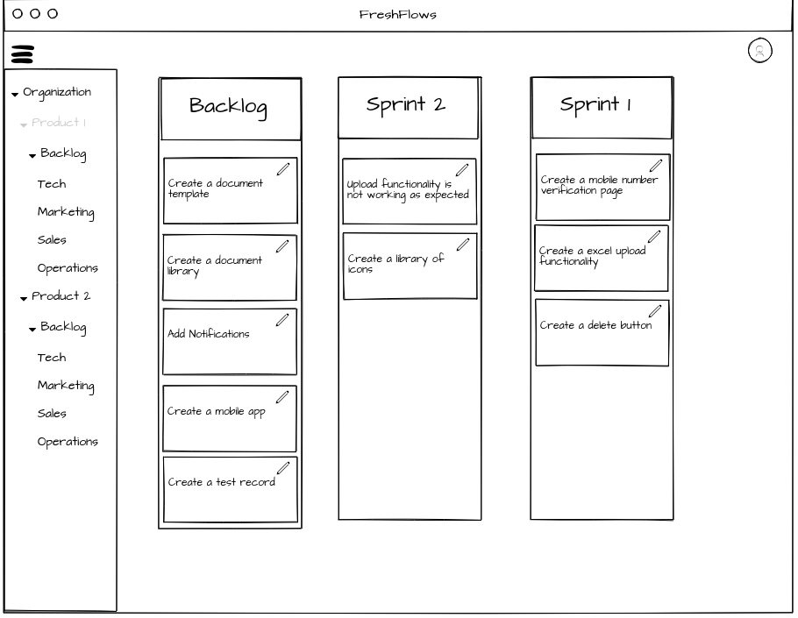
Wireframe - Create Backlog & Plan Sprint
User can create a Organization and Product under the Organization
User can add a requirement to Backlog and Sprints
User can create different Projects under the product.

Slide 26
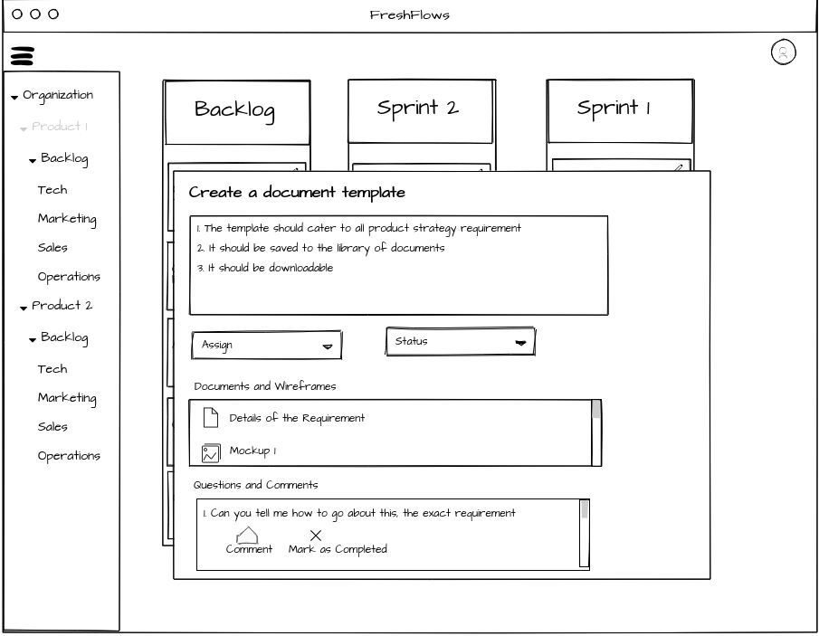
Wireframe - Manage Requirement
User can edit and manage the requirements
Users can raise questions to each other
These questions can be assigned to individuals
User can answer and close the question within the requirement
User can assign the requirement and change the status of the requirement
User can add documents and screen wireframes to the requirement.

Slide 27
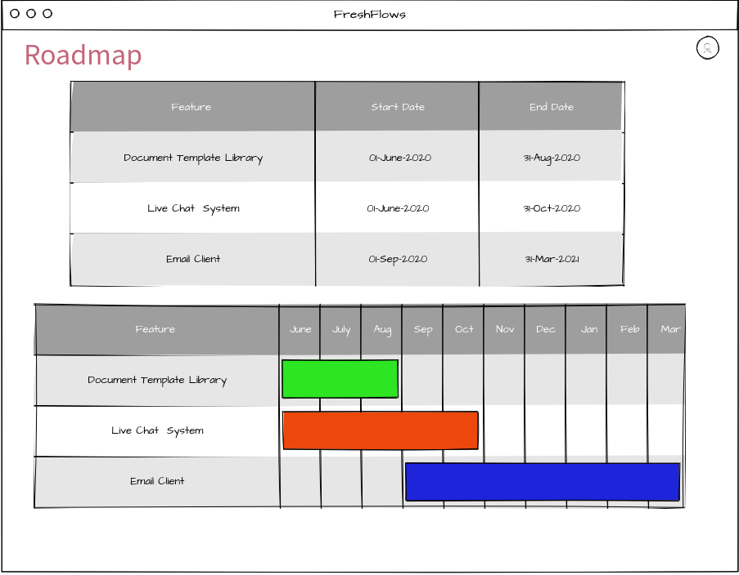
Wireframe - Create Roadmap
User can create the roadmap
User can view the roadmap in normal and gantt chart format
User can download the roadmap
User can share the roadmap with other users

Slide 28
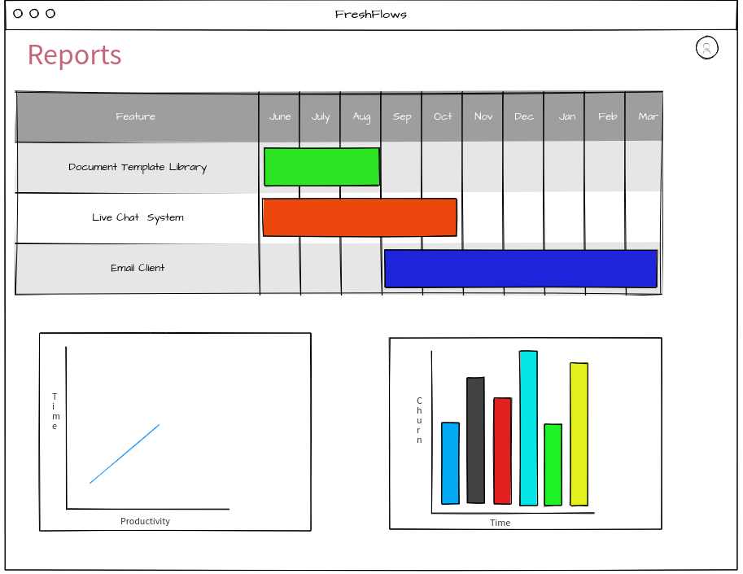
Wireframe - Create Reports
User can create reports
User can view the reports in single screen, or each report in one screen
User can edit the reports
User can download the reports
User can share the reports with other users

Slide 29
Success Criteria
Following metrics need to be tracked to measure the success criteria:
Conversion Ratio = Number of users subscribing to Freshflows / Total number of users registered
Churn Ratio = Number of users unregistering from the app / Total number of users registered
Bounce Rate = Number of users opening the app but not registering / Total number of users opening the app
Usage Ratio = Number of users using the app in the Organization / Total number of users registered in the same organization
Cohort Analysis of the users registering to the app over a period of six months
Number of users reporting a bug/Total number of users
NPS after 6 months of launch

Slide 30
Pricing Plan
Based on the pricing of other competitors, the product can be priced as below
Features | Free Plan | $10 / User / Month | $20 / User / Month
Backlog Creation | Yes | Yes | Yes
Requirement Management | Yes | Yes | Yes
Report Creation and Export | Yes | Yes | Yes
Report Sharing | No | Yes | Yes
Dashboard View of the Reports | No | Yes | Yes
Roadmap Creation and Export | No | Yes | Yes
Roadmap Sharing | No | Yes | Yes
Gantt View of the Roadmap | No | Yes | Yes
Number of Products | 1 | 5 | Unlimited
Analysis of the development cycle | No | No | Yes

Slide 31
Marketing Plan
Content Marketing
Blogs
Posts and Feeds
Webinars
Online Advertising
Google Ads
Facebook
Linkedin
Relationship Marketing
Hosting Events
Participating in Conferences

Slide 32
Thank You

